Slide 1
12307 - anagram

Slide 2
Description
Given a list of strings, find unique strings that do not have any anagram.
[Definition] Anagram:
If one string s1 can be transformed to another string s2 by rearranging letters, s1 and s2 are anagrams of each other.
E.g. apple and eppla are anagrams of each other.

Slide 3
Naïve method
Read all strings
For each string
Traverse every other string to check if anagram exists
If no, add the string to the answer set
for every string s1:
has_anagram = false
for other strings s2:
if s1 is anagram of s2:
has_anagram = true
if not has_anagram:
answer.add(s1)

Slide 4
Naïve method
Problem:
Many redundant checkings are done.
That is, if A is anagram of B, then B must be anagram of A, too!
No need to check B again

Slide 5
Idea
Analyze every string and create a charset for it.
By comparing charsets of two strings, we can quickly check if they are anagrams of each other.
E.g.
string
charset
Apple
aelpp
anagram
eppla
aelpp
Not anagram
appla
aalpp

Slide 6
Idea
Checking anagram by searching in the charset pool, rather than in the set of all strings.
Since #charsets <= #strings
Use only one for loop to do checking
Simply do input and checking at the same time

Slide 7
Something like this
pool
All charsets that have appeared
Analyze
input
Original
string
charset
unique
Strings without anagram so far

Slide 8
Something like this
pool
All charsets that have appeared
Find
anagram
input
Original
string
charset
charset
unique
Strings without anagram so far

Slide 9
Something like this
pool
All charsets that have appeared
Find
anagram
input
Original
string
charset
charset
unique
Strings without anagram so far
If hit: anagram exists
> remove previous anagram from unique set

Slide 10
Something like this
pool
All charsets that have appeared
Find
anagram
input
Original
string
charset
charset
unique
If not hit: it’s uique
> update pool and unique set
Strings without anagram so far

Slide 11
charset
Use std::string to present the charset of each string
Pros:
Convenient to do comparison and sort
Do not need to declare a new container to store info
string
charset
ApPle
aelpp

Slide 12
Pool
map
key
value
aelpp apple
Use std::map to record { charset }
Key: the sorted character set
Value: the first appeared anagram string
Pros:
Can record character set and first appeared string
Convenient to find if the same charset exists
charset
original
string
(for convenience to erase previous anagram from unique set)

Slide 13
Unique set
Use std::set to record all unique strings
Pros:
Convenient to do insert and erase
Natural ordering is alphabetical
Unique set
sample
unique
…

Slide 14
Algorithm
Input string s
Transform s to ordered charset string ls
Check if ls has appeared before
If yes, remove the anagram of s from the unique set
If no, add ls into the charset pool and s into the unique set

Slide 15
Testcase:
apple
Eppla
apePl
sample
anagram
gramana
unique
map
key
value
apple
(sorted) => aelpp
unique

Slide 16
Testcase:
apple
Eppla
apePl
sample
anagram
gramana
unique
map
key
value
Find ‘aelpp’ in the map
no match
apple
(sorted) => aelpp
unique

Slide 17
Testcase:
apple
Eppla
apePl
sample
anagram
gramana
unique
map
key
value
insert
aelpp apple
apple
(sorted) => aelpp
unique
apple

Slide 18
Testcase:
apple
Eppla
apePl
sample
anagram
gramana
unique
map
key
value
aelpp apple
Eppla
(sorted) => aelpp
unique
apple

Slide 19
Testcase:
apple
Eppla
apePl
sample
anagram
gramana
unique
map
key
value
Find ‘aelpp’ in the map
Already existed
aelpp apple
Eppla
(sorted) => aelpp
unique
apple

Slide 20
Testcase:
apple
Eppla
apePl
sample
anagram
gramana
unique
map
key
value
Remove from unique list
aelpp apple
Eppla
(sorted) => aelpp
unique
apple

Slide 21
Testcase:
apple
Eppla
apePl
sample
anagram
gramana
unique
map
key
value
aelpp apple
apePl
(sorted) => aelpp
unique

Slide 22
Testcase:
apple
Eppla
apePl
sample
anagram
gramana
unique
map
key
value
Find ‘aelpp’ in the map
Already existed
aelpp apple
apePl
(sorted) => aelpp
unique

Slide 23
Testcase:
apple
Eppla
apePl
sample
anagram
gramana
unique
map
key
value
Remove from unique list
aelpp apple
apePl
(sorted) => aelpp
unique

Slide 24
Testcase:
apple
Eppla
apePl
sample
anagram
gramana
unique
map
key
value
aelpp apple
sample
(sorted) => aelmps
unique

Slide 25
Testcase:
apple
Eppla
apePl
sample
anagram
gramana
unique
map
key
value
Find ‘aelmps’ in the map
No match
aelpp apple
sample
(sorted) => aelmps
unique

Slide 26
Testcase:
apple
Eppla
apePl
sample
anagram
gramana
unique
map
key
value
insert
aelpp apple
sample
aelmps sample
(sorted) => aelmps
unique
sample

Slide 27
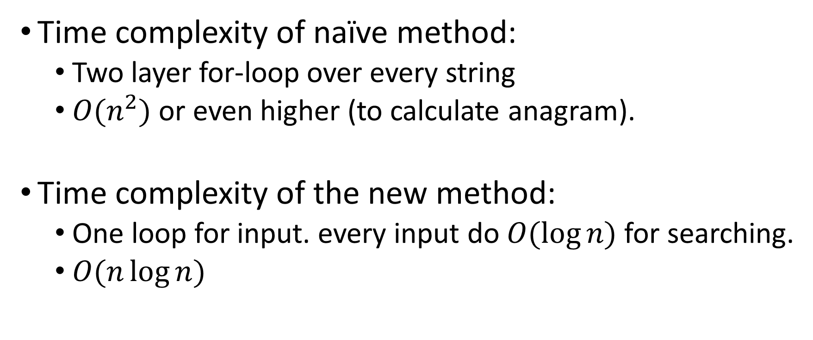
Analyze
Time complexity of naïve method:
Two layer for-loop over every string
$O(n^{2})$ or even higher (to calculate anagram).
Time complexity of the new method:
One loop for input. every input do $O(\log{n})$ for searching.
$O(n\log{n})$

Slide 28
Implement
String Transform
Anagram searching

Slide 29
main()
std::map<std::string, std::string> strMap;
std::set<std::string> uniSet;
int main()
{
int n;
std::cin >> n;
while(n--){
// input strings
std::string s, ls;
std::cin >> s;
ls = Transform(s);
findAnagram(s, ls);
}
// output uniSet strings
for(auto s : uniSet){
std::cout << s << std::endl;
}
return 0;
}

Slide 30
String Transform
change string into charset
string Transform(string str)
{
string ls;
for(char c : str)
ls.push_back(tolower(c));
sort(ls.begin(), ls.end());
return ls;
}

Slide 31
findAnagram(string, string);
void findAnagram(string &s, string &ls)
{
auto iter = strMap.find(ls);
if(iter!=strMap.end()){
uniSet.erase((*iter).second);
}else{
uniSet.insert(s);
strMap[ls] = s;
}
}

